Slide 1


Service Provider Perspectives on Alcohol Harm Reduction: Advancing SDG 3.5 through Strengthened Prevention and Treatment of Harmful Alcohol Use in South Africa
Dr. Thembinkosi Singwane* & Prof Stephan Geyer
(Department of Social Work and Criminology, University of Pretoria)
2025 ASASWEI Conference
University of Free state, Bloemfontein

Slide 2

Presentation Outline
Introduction and Background
Lacuna/ research problem
Research Questions
Methods
Findings
Implications for Practice
Limitations
Conclusions and Recommendations

Slide 3
Introduction and Background
SDG 3.5 & Alcohol Harm Reduction: Why Social Workers Should Care
🎯 SDG 3.5 Goal: Strengthen prevention & treatment of substance abuse, incl. harmful alcohol use
🌍 Why It Matters (South Africa): 🍻 High per-capita alcohol consumption ⚠️ Links to violence, HIV/AIDS, poverty, family breakdown 🏥 Huge burden on health & social systems
🤝 Why Social Workers Should Care: 🧑‍⚕️ Frontline in prevention, treatment & advocacy 👨‍👩‍👧 Address psychosocial impacts on families & communities 🌱 Drive community-based, rights-focused interventions 📢 Essential for achieving SDG 3.5

Slide 4
Introduction and Background
Harmful Alcohol Use – A Global and Local Concern
🍷 Harmful alcohol use is linked to 200+ diseases and causes over 3 million deaths annually, contributing to high global morbidity and mortality. (Okeyo et al., 2022).
🧠 Alcohol Use Disorders (AUDs) are among the most prevalent and devastating mental disorders worldwide, with profound health and social impacts.
⚠️ Treatment of AUDs and management of alcohol-related harms remain a persistent challenge across health and social systems. (Stockwell, Zhao, Pauly, Chow, Vallance, Wettlaufer, Saunders & Chick, 2021)
🌍 The harm reduction model is gaining global momentum as a pragmatic approach to AUDs. (Geyer & Lombard, 2014:342)
In South Africa, the Department of Social Development (DSD) has begun integrating harm reduction within its National Drug Master Plans, reflecting progress but also highlighting ongoing gaps. (Department of Social Development, 2020)

Slide 5
BRIEF INTRODUCTION
But what is alcohol harm reduction?
Alcohol harm reduction is an effort that aims to reduce the undesired and unhealthy (alcohol harms) consequences brought by a particular behaviour (e.g., alcohol use), without the necessity of Total Abstinence.
Examples of successful harm reduction
-COVID19
-Stationery-preventative measures for teenage pregnancy.
-Alcohol labels.
-Seatbelt in a car
N:B Hence, the study was centred on the harm reduction approach

Slide 6
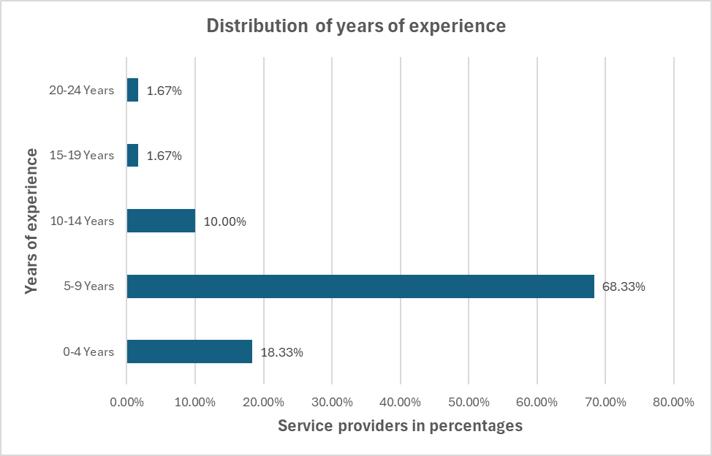
BRIEF INTRODUCTION & AIM
Service providers in treatment centres play a vital role in rendering alcohol harm reduction interventions.
Aim- to present results from 60 Service providers from Mpumalanga, Limpopo and Gauteng on their perspectives on harm reduction approaches, the implementation of harm reduction approaches, and the effectiveness of alcohol harm reduction strategies amongst other factors.
The below two tables represent the service providers who formed part of the study
Professional Registration | Frequency | Percentage
SASCCP | 56 | 93.33%
HPCSA | 3 | 5%
Other | 1 | 1.67%

Slide 7
Lacuna/ research problem
Only Total abstinence is preferred, which is difficult for service users with ambivalence- harmful alcohol use continues
Development of harmful alcohol harm reduction interventions (AHRI) is difficult, and the interventions are misunderstood
Several service providers are not trained in alcohol harm reduction interventions
Resource constraints for implementing AHRI
Measuring AHRI impact may be difficult for outpatient centres
Notes:
-Developing harmful alcohol harm reduction interventions is no easy feat; however, they are much needed to deal with the harms associated with alcohol use. Hence, as a growing public health concern, the WHO even developed a global strategy to reduce the harmful use of alcohol in 2018 (World Health Organization, 2019)
-

Slide 8
RESEARCH QUESTIONS
Main question
What are the perspectives of service providers (Social workers, nurses and psychologists) on harm reduction approaches, the implementation of harm reduction approaches, and the effectiveness of alcohol harm reduction strategies amongst other factors?
Some of the Sub-questions
Which treatment models are service providers aware of?
Is the harm reduction approach suitable for treating harmful alcohol use?
Is enough being done regarding alcohol harm reduction interventions?
What are the potential harms that could be mitigated by outpatient alcohol harm reduction interventions?
What training (and at which level) do service providers possess regarding substance abuse and alcohol harm reduction approaches?
Is there enough resources in the respective outpatient centres to implement the harm reduction approach?
Do outpatient centres utilize alcohol harm reduction
Can alcohol harm reduction be implemented concurrently with other treatment models
Advantages and disadvantages of alcohol harm reduction approach in outpatient treatment centres?
What could be the content of the alcohol harm reduction intervention.
RESEARCH QUESTIONS

Slide 9

How did the study unfold?

Slide 10
RESEARCH METHODS
Research approach and design
The mixed methods research approach, specifically the concurrent mixed design was adopted for the study (Fouché & Strydom, 2021:424)
Population, sample and sampling procedure
The population of this specific phase of the study consisted of 60 service providers (with <3 years experience) recruited purposively from outpatient treatment centres in GP,LP and MP.
Data Collection
Data from the service providers was collected through a non-standardised Qualtrics^{XM} web-based survey which included open-ended questions and close-ended questions (Roestenburg,2021:211)
Data analysis
Thematic analysis was used to analyse the data collected from the semi-structured interviews after vigorous transcription, and several themes emerged as alluded to in the findings

Slide 11
What was found? Research Results and discussion.

Slide 12
Suitability of harm reduction approach for treating harmful alcohol use
Notes:
Overall, the analysis revealed a strong leaning towards the suitability of harm reduction approaches among service providers, with 70% expressing positive views. However, there remains a sizeable portion of respondents (25%) who were uncertain, indicating areas where further education, evidence, and discussion may be needed to address doubts and ambivalence. The low negative sentiment (5%) suggests that outright opposition to harm reduction is rare among these service providers. These insights highlighted the importance of continued dialogue and research to support and refine harm reduction practices in substance abuse treatment.

Slide 13

Developing alcohol harm reduction interventions.
Is enough being done regarding alcohol harm reduction ?
Notes:
-The analysis indicates a strong consensus among service providers that current efforts in alcohol harm reduction are inadequate, with 90% expressing that "a little is being done." Only a small fraction (10%) believes that enough is being done. This consensus suggests a widespread perception of significant gaps in resources, coverage, support, and impact of harm reduction interventions. The apparent lack of uncertainty further emphasizes the conviction of service providers regarding the need for enhanced and more comprehensive efforts in harm reduction for alcohol use.
-For this study, this means that service providers may recognize the importance of involving service users to ensure that interventions are tailored to their needs and experiences, leading to more effective outcomes. The involvement of service users can also empower them, increasing their engagement and commitment to the interventions. Many modern policies and best practice guidelines advocate for the involvement of service users in the development of health interventions, a similar study (Giacco, Chevalier, Mcnamee, Barber, Shafiq & Wells, 2023:79) in the United Kingdom amongst harmful drinkers also shared similar sentiments, aligning with these providers' views

Slide 14

Possible harms to be addressed by an outpatient harm reduction Intervention
Notes:
The service providers highlighted several key areas of harm associated with alcohol misuse, such as physical health: Chronic diseases (like cardiovascular issues and liver disease) and acute risks (such as alcohol poisoning) were major concerns, indicating the need for comprehensive awareness within the intervention. Moreover, key issues such as mental health were identified as important suggesting the necessity of integrating mental health services into the intervention.
From the analysis, it is clear that the intervention can focus on social and behavioural issues whereby concerns about violence, risky sexual behaviours, can be addressed as strategies to reduce alcohol-related aggression and support affected individuals. Furthermore, the significant recognition of financial difficulties and family problems underscores the need for economic support and family counselling as part of the intervention. Also addressing reproductive health and foetal alcohol syndrome is crucial, highlighting the intergenerational impact of harmful alcohol.
It can thus be deduced that the intervention should be multi-dimensional, addressing physical, mental, social, and economic harms. It should also focus on mental health, violence prevention, economic support, and family counselling. The intervention should also be tailored to provide targeted education on risks and immediate support for acute harms

Slide 15
Association between service providers' years of experience and the awareness of harm reduction approach
Characteristics | Totals, n% |  | Chi-square value | df | p-Values
 | Aware (47) | Not aware (13)
Years of experience 0-4 5-9 10-14 15-19 20-24 | 8 (72.73) 32 (78.05) 5 (83.33) 1 (100) 1 (100) | 3 (27.27) 9 (21.95) 1 (16.67) 0 0 | 0.8472 | 4 | 0.932
Notes:
-The complete awareness in these groups suggests that professionals with longer careers are highly likely to be aware of harm reduction approaches, possibly due to their extensive experience and accumulated knowledge in their practice. Palukka, Haapakorpi, Auvinen and Parviainen (2021:2) argue ,in their study conducted in Finland amongst alcohol harm reduction service providers, that experiential expertise in social and health services is especially important in the treatment of alcohol and substance abuse disorders, and service users gain confidence in their professionals

Slide 16
Perspectives on the concurrent implementation of the harm reduction approach and other treatment models
Notes:
These results are consistent with several authors (Madhombiro et al., 2020; Miller, Ringwalt, Grube, Paschall, Fisher & Gordon, 2019; Papas et al., 2021) across the globe, who pointed out that alcohol harm reduction interventions can be effective if they can be integrated with other treatment models such as motivational interviewing and cognitive behavioural therapy. However, to move forward effectively, the substance abuse field must address concerns about compatibility, provide comprehensive training and resources, and promote an integrated approach to care that values the diverse needs and stages of readiness of the service users with harmful alcohol use.

Slide 17
Advantages and disadvantages of alcohol harm reduction interventions in outpatient centres
Advantages | Disadvantages
Reduction in alcohol-related harms: Fewer accidents, violence, and health issues, with improved mental and physical health. | Risk of continued harmful alcohol use: May lead to ongoing alcohol consumption without the goal of total abstinence.
Accessibility and convenience: Allows individuals to continue daily activities (work, school) while receiving treatment. | Misinterpretation and misconceptions: May be misunderstood by service users and communities as promoting alcohol use.
Cost-effectiveness: Outpatient interventions are less expensive compared to inpatient care. | Implementation challenges: Lack of training, controlled environments, and financial resources can hinder effectiveness.
Flexibility and personalized care: Tailors treatment to individual needs with involvement of family and community. | Effectiveness concerns: Long-term outcomes, like total sobriety, may take time to achieve, raising doubts about the approach's impact.
Reduction in stigma: Nonjudgmental and allows service users to seek treatment discreetly, lowering social stigma. | Delays in outcomes: Harm reduction might not show immediate positive impacts, delaying progress towards abstinence.
Notes:
-Developing harmful alcohol harm reduction interventions is no easy feat; however, they are much needed to deal with the harms associated with alcohol use. Hence, as a growing public health concern, the WHO even developed a global strategy to reduce the harmful use of alcohol in 2018 (World Health Organization, 2019)
-

Slide 18
Implications for Practice in Outpatient treatment settings
Implication for Practice | Description | Practice Change
Balancing Harm Reduction and Abstinence Goals | Need to clearly define harm reduction vs. abstinence goals. | Implement dual-focused programs that offer harm reduction as a step towards abstinence if desired.
Comprehensive Training for Staff | Service providers require better training in harm reduction principles. | Provide specialized training programs to ensure staff can effectively implement and explain harm reduction.
Addressing the Risk of Continued Use | Outpatient settings might not provide enough supervision to prevent relapse. | Introduce frequent check-ins, peer support systems, and mobile health tools to monitor progress.
Enhancing Family and Community Involvement | Involvement of family and community is crucial for supporting recovery and reducing stigma. | Offer family counseling, community workshops, and public education programs to engage broader support networks.
Reducing Stigma and Offering Nonjudgmental Care | Harm reduction can minimize the stigma associated with seeking treatment. | Foster a nonjudgmental, inclusive culture in the center, emphasizing client-centered care and privacy.
Tailoring Treatment to Individual Needs | Flexibility allows for personalized care, crucial for effective treatment. | Develop flexible, customizable treatment plans based on individual client progress and circumstances.
Clear Communication to Avoid Misinterpretation | Misunderstanding harm reduction principles could hinder treatment. | Provide clear messaging about harm reduction, emphasizing its focus on reducing risks, not endorsing use.
RESEARCH QUESTIONS

Slide 19
How Social Workers Can Advance SDG 3.5
1. Prevention and Education
🧑‍🏫 Deliver community-based awareness programmes on responsible drinking, risks of harmful use, and protective behaviours.
🎓 Integrate alcohol harm education in schools, workplaces, and youth programmes.
💬 Use culturally relevant communication strategies to challenge stigma and myths about alcohol use.
2. Early Identification & Intervention
🩺 Screen individuals and families for early signs of alcohol misuse.
🛡️ Provide brief interventions and referrals to treatment services before AUDs escalate.
👨‍👩‍👧 Work closely with families to build resilience and reduce intergenerational cycles of alcohol harm.
3. Treatment & Harm Reduction
🤝 Incorporate harm reduction strategies (e.g., safer drinking practices, relapse prevention, risk reduction).
🧠 Integrate psychosocial support with clinical care, including counselling, anger management, and trauma-informed therapy.
🌱 Promote holistic models that link mental health, employment, housing, and social support with AUD treatment.

Slide 20
How Social Workers Can Advance SDG 3.5 from the Harm reduction approach??
4. Advocacy & Policy Influence
📢 Advocate for alcohol harm reduction policies (e.g., restrictions on availability, pricing, advertising).
🏛️ Influence National Drug Master Plan implementation to ensure harm reduction is prioritised.
⚖️ Champion the rights of marginalised populations disproportionately affected by alcohol-related harm.
5. Capacity-Building & Research
📚 Strengthen training of social workers in harm reduction approaches.
🔍 Contribute to research and monitoring of alcohol interventions in South Africa.
🤲 Share practice-based evidence to inform locally grounded strategies that align with SDG 3.5.
KEY MESSAGE (Take home)
✅ In short: social workers should advance SDG 3.5 by bridging prevention, treatment, advocacy, and community empowerment, ensuring that alcohol harm reduction is not just a health issue, but also a social justice priority.
.

Slide 21

Limitations
As with all research studies this research study had its own limitations
Only a few service providers (n=60) from outpatient treatment completed the survey therefore the findings cannot be generalized to all outpatient treatment centres. Furthermore, only service providers from Limpopo, Mpumalanga and Gauteng were sampled therefore the results cannot be generalized Nationally.
Service providers lack of awareness of the harm reduction approach might have skewed the data interpretation.

Slide 22
In summary,
In conclusion, from the service providers’ perspectives, it seems implementing harm reduction approaches in outpatient drug treatment centers offers significant advantages, including improved accessibility, cost-effectiveness, and personalized care.
But also presents challenges like the risk of continued substance use, stigma, and misinterpretation.
To optimize these approaches, centres must balance harm reduction with abstinence goals, ensure comprehensive staff training, engage family and community support, and provide clear communication to avoid misconceptions. By addressing these barriers and integrating flexible, evidence-based strategies, harm reduction can enhance the effectiveness and accessibility of treatment while also reducing harmful alcohol use.

Slide 23



