Slide 1

Resilience strategies of families post-COVID-19 Pandemic in Polokwane, South Africa
By
DR DJ RAMOSHABA
SENIOR LECTURER, UNIVERSITY OF LIMPOPO

Slide 2
INTRODUCTION
In the past, many other viruses came and disturbed human life activities. (For instance, there was an outbreak of Severe Acute Respiratory Syndrome (SARS) in November 2002, which was the first coronavirus epidemic to have a high mortality rate and to provoke widespread alarm).
In December 2019, a new coronavirus (COVID-19) was discovered in Wuhan, which is in the Hubei Province of China, and spread quickly across the globe, including in South Africa (WHO, 2020).
WHO (2023) reported that in South Africa, from 3 January 2020 to 18 October 2023, there have been 4,072,533 confirmed cases of COVID-19 with 102,595 deaths.
The COVID-19 pandemic negatively affected the lives of many individuals within some families.
It is from this background that this study sought to explore the resilience strategies of families in Polokwane.

Slide 3
RESEARCH PROBLEM
The South African government imposed a lockdown in the country to help curb the spread of the virus. However, it is worth noting that such lockdowns also harmed people’s livelihoods.
This is supported by the United Nations Economic Commission for Africa [UNECA] (2020), which found that economic challenges such as increased poverty and unemployment levels surfaced during the COVID-19 pandemic.
Some individuals lost their loved ones, whilst some experienced mental health issues as a result of the COVID-19 Pandemic.
Several studies show that pandemics such as COVID-19 instigate more problems, such as domestic violence, which negatively affect the functioning of families (Rubenstein, Lu, MacFarlane & Stark, 2020; Seddighi, Salmani, Javadi & Seddighi, 2019).
Enarson (2001) and the World Health Organisation [WHO] (2012) share that violence at home substantially increases post-disasters.
Many studies (Ramoshaba 2023; Gayatri, 2022; KA Chu · 2021; Roman, 2021) have been conducted on the impact of the COVID-19 pandemic, but there is a gap in the studies that explored the resilience strategies of Families post the COVID-19 pandemic.
It is from this background that the study sought to explore the Resilience strategies of families post-COVID-19 Pandemic in Polokwane, South Africa.

Slide 4
THEORETICAL FRAMEWORK
Resilience theory
It is very crucial to focus on how people cope with challenges than on the challenges they face only. It is for this reason that this study used the resilience theory which was founded by one of the pioneers of resilience Norman Garmezy in 1974.
Garmezy defines resilience as the capacity for recovery and adaptive behaviour upon initiating a stressful event (Garmezy, 1974). In the same breath Zeidan-Lukacs (2013) describes resilience as the capacity to maintain competent functioning in the face of major life stressors.
Families have been affected by the COVID-19 pandemic wherein they had to employ various resilience strategies which were understood by the researcher through the lenses of this theory.

Slide 5

THEORETICAL FRAMEWORK CONT…
According to Samanta (2017), the resilience theory is relevant for researchers who seek to close research gaps in the resilience studies by offering them an understanding of how people cope with challenges.
This means that the theory serves as a guide in understanding the different spheres of individuals and families.
In this study the resilience strategies that families employed in mitigating the impact of the COVID-19 pandemic was clearly analysed and interpreted through the lenses of the resilience theory.
The theory is relevant for this study as the study was qualitative in nature and Van Breda (2018) avers that most researchers use the resilience theory in qualitative studies as it allows them to source and understand participants’ knowledge and views.

Slide 6
METHODOLOGY
The study followed a qualitative approach to understand the resilience strategies of selected families in Polokwane. The approach was relevant in this study as qualitative approaches are always about understanding the social life as well as the meaning that people attach to everyday life (De Vos, St rydom, Fouche, & Delport, 2011).
This was a case study of selected families in Polokwane which is in the Limpopo province of South Africa. The use of a case study was motivated by Yin (2009) who posit that a case study design is mostly useful when researchers have a hunch to launch an enquiry of occasions.
The researcher used convenient and snowball sampling techniques to select eight families to share their resilience strategies in response to the impact of the pandemic in their families.
Data in this study was collected through semi-structured interviews wherein family members were interviewed individually to allow them to express themselves freely. Data collection was guided by data saturation.
Thematic content analysis was used to analyse the data. To ensure the quality of the findings, prolonged engagements, member checking and peer examination were ensured, and field notes were written directly after each interview with each respondent for auditing purposes.

Slide 7
FINDINGS AND DISCUSSIONS
THEME 1: THE USE OF SUBSTANCES AS A COPING STRATEGY
Some respondents reported smoking and alcohol consumption as their coping strategies for mitigating the hardships that the COVID-19 pandemic brought in their lives
The respondents believe that using substances helps to cope with their difficult situations. Similar findings by Wu, Liu, Fang, Fan, Fuller, Guan, Litvak (2008) shows that during the early SARS outbreaks, some individuals reported the use of alcohol to cope with unpleasant feelings during pandemics.
Patrick, Bray, and Berglund (2016) aver that the use of substances as a coping strategy has increased markedly in the past years during pandemics and is associated with later symptoms of substance use disorders.

Slide 8
Theme 1 cont…
People’s lives had to change because of the COVID-19 pandemic which introduced numerous changes to people’s lives, including isolation, stress, and economic hardships which they dealt with by using marijuana and alcohol to cope with (Patrick, Parks, Fairlie, Kreski, Keyes & Miech, 2022).
it must be noted that although some people use alcohol as a coping strategy, it does not make alcohol use a positive coping strategy.
In the same breath, Hogarth, Martin and Seedat (2019) avers that some individuals use dysfunctional coping strategies such as alcohol to cope with challenges that are brought by disasters and pandemics which also negatively affect their health and well-being.

Slide 9
THEME 2: EXPLORING AND USING RELIGIOUS SERVICES.
Some respondents reported that they mitigate the impact of the COVID-19 pandemic by employing religious coping strategies such as prayer.
Some of the respondents reported that prayer works for them as it within their belief and religion to pray to overcome challenges.
In the same breath Farley, Galves, Dickinson and Perez (2005) reported that people use religion for positive reframing and acceptance of their life situations.

Slide 10
Theme 2 continues…
According to Schottenbauer, Klimes-Dougan, Rodriguez, Arnkoff, Glass and LaSalle (2006), religious coping strategies such as prayer are used together with emotional support for mitigation of challenges.
In other words, religious people have the capacity to deal with difficult situations and avoiding stress and anxiety that may be brought by difficult life situations (Watterson & Giesler, 2012).
It should be noted that prayer is regarded as a coping strategy for those who are religious and spiritual. Toburen and Meiew (2010) add that, people who are religious are able to cope with difficult situations and complete the tasks in their lives by believing in the word of God at any level of their religion.
Watterson and Giesler (2012) aver that in difficult situations religious people are able to have the capacity to have self-control and overcome challenges.

Slide 11
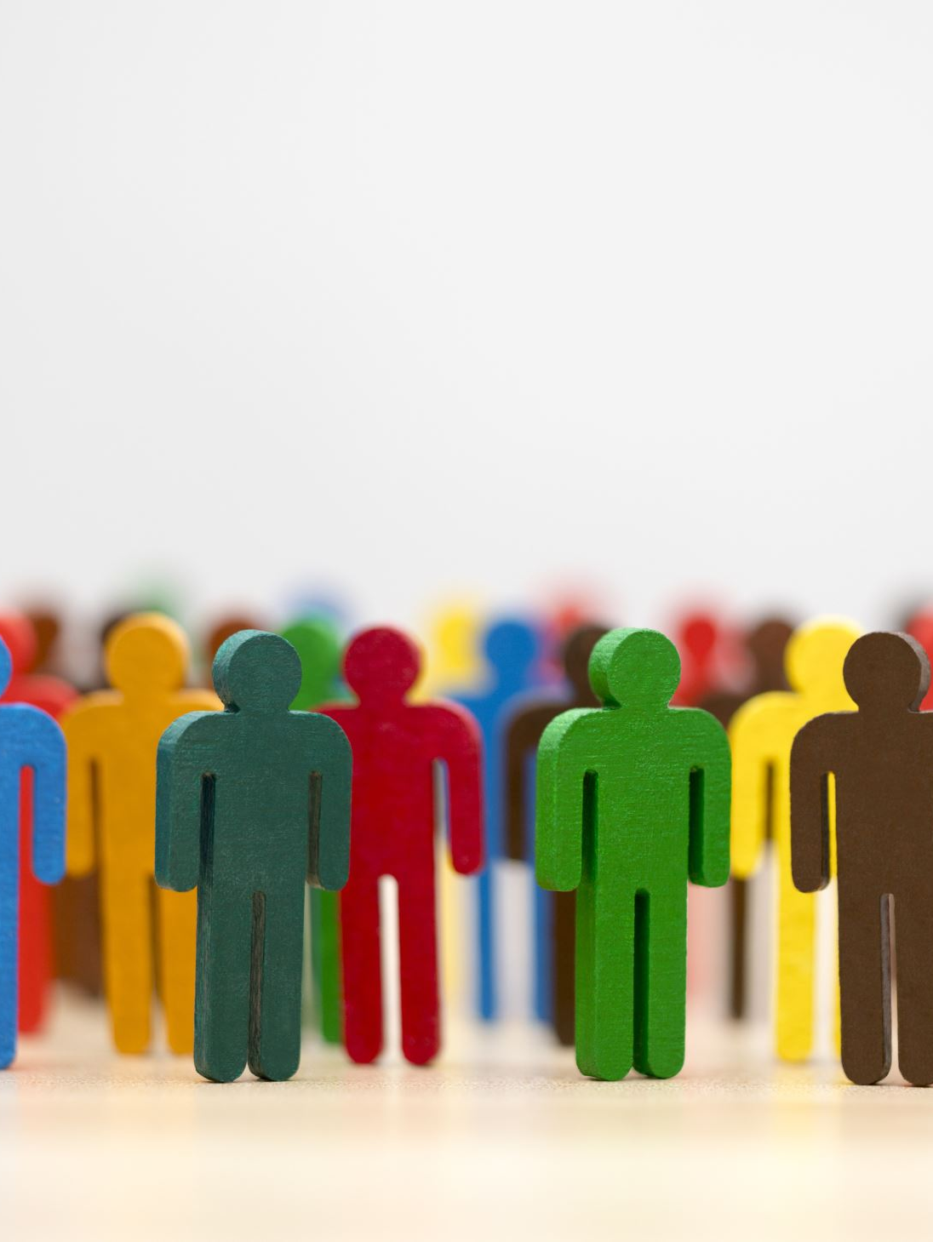
THEME 3: FAMILY AND PEER SUPPORT
Some respondents highlighted that they rely on their close family members and friends for support.
The respondents further highlighted that their close individuals plays a crucial role of mitigating the impact of the COVID-19 pandemic.
It should be noted that that support from family members and friends can help people mitigate challenges and better their lives. This is in line with Komito (2011) who asserts that support systems help better living conditions of individuals and assist in having people who might be willing to offer support and help in times of need.

Slide 12
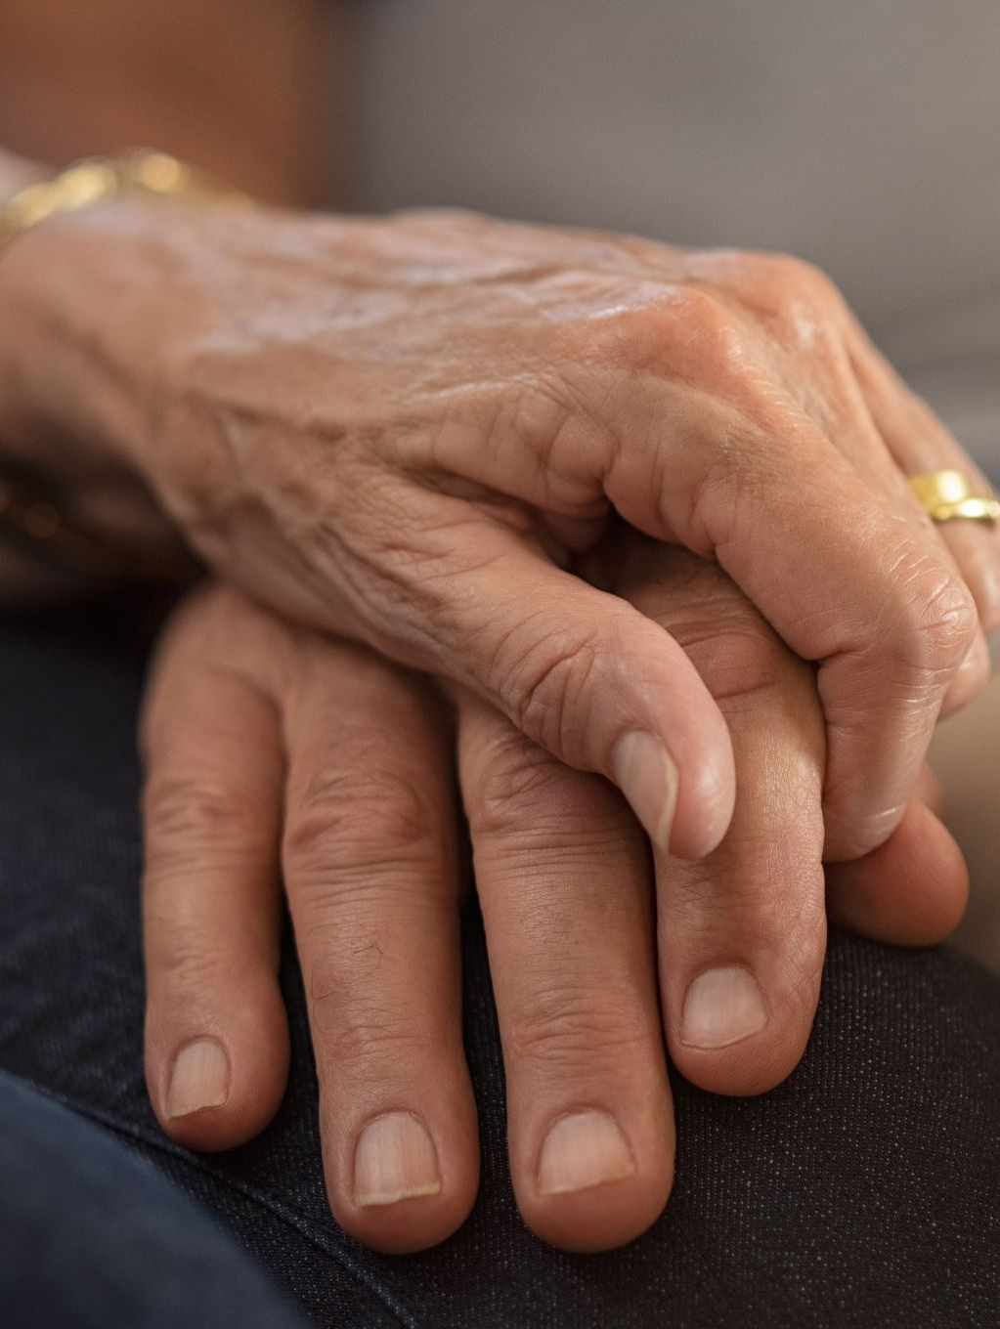
Theme 3 continues….
According to Nguyen, Chatters, Taylor and Mouzon (2016), social support and positive social relationships are important in the protection of individuals against depression as people who have high levels of social support from families and friends are less likely to be depressed in difficult situations.
In the same breath, Lincoln and Chae (2012) found that frequent emotional support from family and friends is important as it helps to decrease the chances of depression for people who are facing difficult situations.
Effective social support has consistently been reported to protect individuals from developing mental health problems when they experience stressors (Xu, & He, 2012).

Slide 13
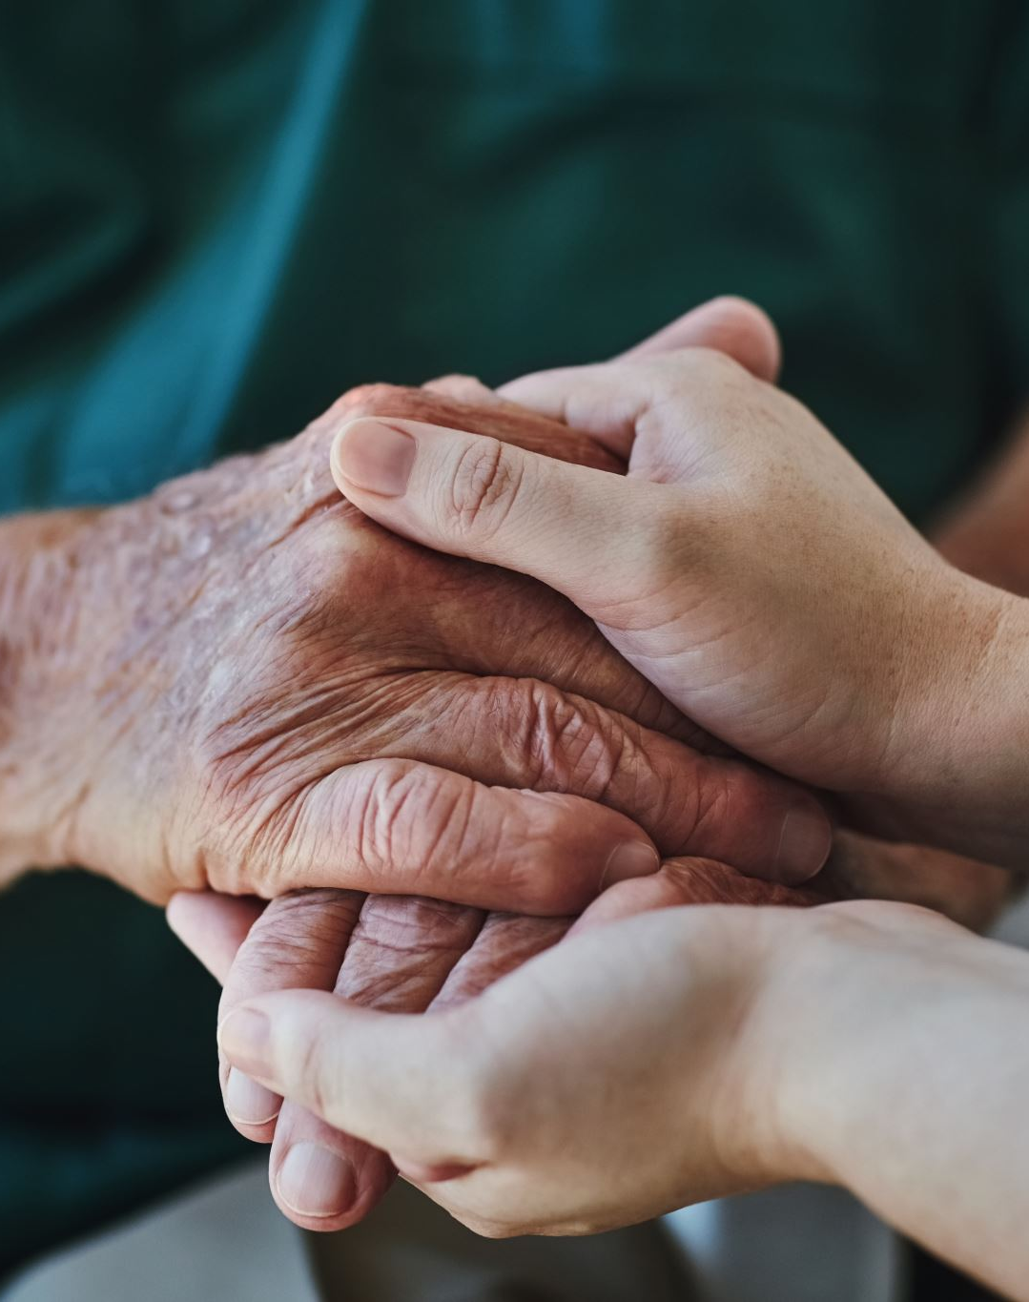
Theme 3 cont….
Some respondents indicated that having a good relationship with their family members help them to successfully mitigate the COVID-19 impact in their lives.
Gutiérrez and Zavella (2009) support the findings by stating that having good relationships with close individuals is crucial because it allows one to get advice, encouragement, motivation or help on important issues

Slide 14
THEME 4: THE USE OF GOVERNMENT SERVICES
The respondents have reported that they use Government services such as social grant and food parcels to cope with the impact of the COVID-19 pandemic.
It must not be ignored that the impact of the COVID-19 pandemic that resulted from the lockdown regulations such as home confinement, has led to some individuals and families with income loss which required mitigation strategies which is why some relied on social grant and services such as food parcels.
This shows the importance of government services in the stability and survival of individuals and families. This is in line with van der Berg, Siebrits and Lekezwa (2010) who posit that social security systems such as providing citizens with grant provides protection against challenges such as unemployment and income loss.

Slide 15
Theme 4 Cont…
According to Shi (2012), the government has a primary role and responsibility of strengthening support, providing resources such as food and facilities during disasters as a reduction and management strategy.
This places an emphasis on the important role of government during natural disasters such as the COVID-19 pandemic, however it does not mean that it is only the role of the government that is crucial in the mitigation and responses of disasters.

Slide 16
CONCLUSIONS AND RECOMENDATIONS
The impact of the COVID-19 pandemic on the functioning of families can be noted from the findings of this study which led to some individuals and families developing coping mechanisms.
The findings of the study reveal the use of substances, religious services, family and peer support as well as government services as some of the coping strategies that were employed by some individuals and families in Polokwane.

Slide 17
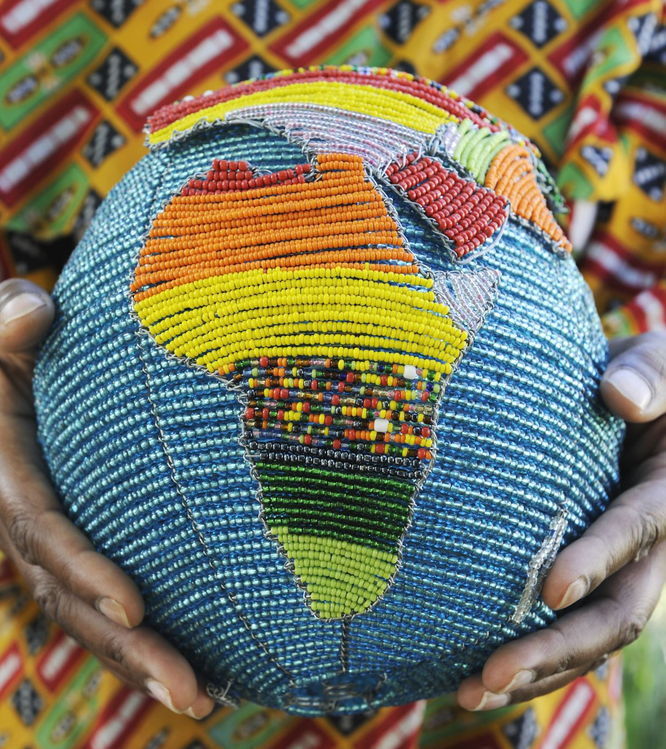
CONT..
The following recommendations are provided:
The South African government should develop programmes that are going to respond to the use and abuse of substances during natural disasters.
More Research is recommended to help develop effective programmes and strategies for responding to natural disasters such as the COVID-19 pandemic.

Slide 18
THE END
THANK YOU

