Slide 1

Title: EFFECTS OF YOUTH SUBSTANCE MISUSE ON THE MOTHER'S ROLE
SEPTEMBER 2025
Dr F Mathibela
Dr J Masombuka
ASASWEI

Slide 2

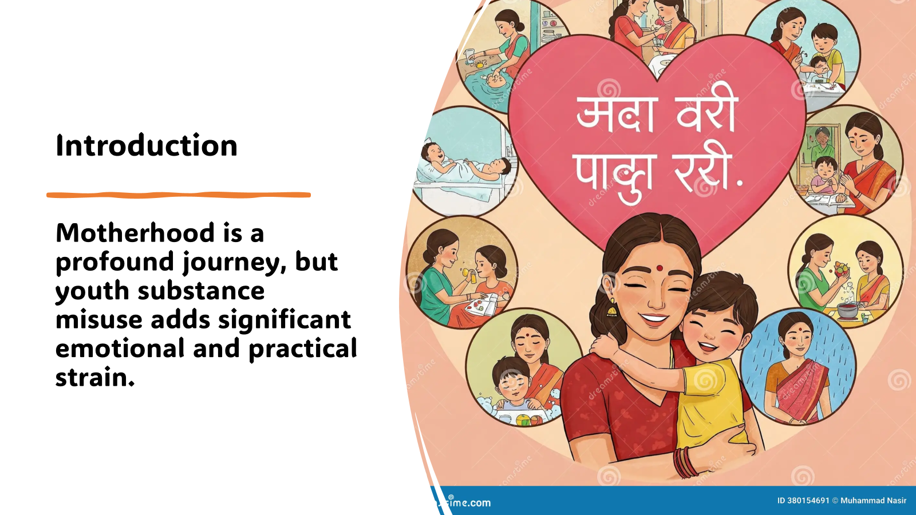
Notes:
Abstract
The following three questions were asked
How has it been living with a youth/child who is using substances?
How has living with a child/youth misusing substances affected your role as a mother?

Slide 3
Background
Youth face pivotal transitions—education, career, identity—which heighten vulnerability to substance misuse (Patrick et al., 2024).
Female-headed households are increasingly common in Africa, placing mothers at the centre of caregiving.
Substance misuse affects over 316 million people globally (2023), with youth increasingly impacted.
Youth admissions to treatment centres are rising—16% under age 18, with Cannabis dominant (84% in Gauteng).

Slide 4
Methodology
A qualitative, exploratory approach was adopted to uncover the lived experiences of mothers in Gauteng.
Purposive & snowball sampling identified 10 mothers in Tshwane.
Semi-structured interviews emphasised empathy, respect, and active listening (Geyer, 2021).
Grounded in social work values and an ecological theoretical framework.
Notes:
The following three questions were asked
How has it been living with a youth/child who is using substances?
How has living with a child/youth misusing substances affected your role as a mother?

Slide 5
Findings
 | Themes | Sub-themes
Theme 1 | Emotional and psychological journey of mothers of youth misusing substances | Family conflict Stigma and isolation Societies’ expectations and pressures Challenges with health
Theme 2 | Effects on the mother’s role in living with youth misusing substances | The role of the mother as a caregiver The role of the mother as a caregiver to other siblings Family disruptions
Notes:
Sub-themes 1.1 Family conflict
Mothers shared how their lives were turned upside down due to the youth misusing substances. Some mothers even shared that they are being looked at differently by family members and relatives, as they are perceived as failures in raising their children.
Sub-theme 1.2: Stigma and isolation
Mothers shared that stigma surrounding maternal struggles has prevented them from seeking the help they need. Moreover, they shared that the demands of caring for a youth misusing substances have limited their social interactions, as they also feel ashamed to be around friends and relatives.
Sub-theme 1.3: Societies’ expectations and pressures
Mothers shared that they are expected to forever be available for their children while also continuing to be fully functional at their workplaces, and also be available as caregivers for other siblings, be a wife, and also be available for other family matters. They shared their frustrations as all these expectations are directed at them, other than their partners.
Sub-theme 1.4 Health issues
Mother feel depressed and anxious because of their child’s substance abuse. They compromise their activities, including their families, to accommodate the affected child. They may also put their careers on hold. Parenting at this stage becomes more complex; the life of compromising even their happiness becomes a regular part of their lives (Tollefson et al. 2017).
Sub-theme 2.1 The role of the mother as a caregiver
Mothers shared that due to youth substance misuse, they are mostly experiencing emotional distress, grieving the loss of the child they had, etc.
Sub-theme 2.2 The role of the mother as a caregiver to other siblings
Mothers shared that they struggle to focus on caring for other siblings
Sub-theme 2.3 Family disruptions
Mothers shared that their family routines are disrupted due to not knowing when the child who misuses substances will relapse or start having behavioural problems. Sitting on a ticking boom

Slide 6

Stories from mothers of youth misusing substances
“I don’t have time for myself. It’s exhausting.”
“I always feel bad as a mother; I can’t shake the feeling that I failed him, and I failed my husband.”
“I feel judged for having two children who use drugs.”
“I wish his father could take him for a while… I feel like a failure”.
“…he is taking the whole pie; I'm struggling to give attention to my other children.”
“….my in-laws say I’m a bad mother for choosing work.”

Slide 7
Discussions
Youth substance misuse is associated with risks to the mother–youth/child relationship
Emotional and psychological journey of mothers of youth misusing substances
Mothers face chronic stress, health issues, and societal stigma.
Their roles as caregivers, partners, and professionals are disrupted.
Notes:
The study aimed to engage with mothers of youth misusing substances and to gain an in-depth understanding of the effects of youth substance misuse on the mother’s role. and the mother’s adaptation to the new role of having a child misusing substances. The issue of substance misuse among youth continues to be a serious challenge, affecting all family members. However, mothers bear an additional burden in the support of youth misusing substances.
The study confirmed that mothers face numerous challenges regarding youth substance misuse.
also highlighting that mothers are mostly exhausted and burned out due to the constant demands of managing a household, while caring for an addicted child’s overall well-being

Slide 8
Conclusions
It was evident that mothers are overly concerned about the extent of damage caused by youth substance misuse.
The results led to a better understanding of the effects of youth substance misuse on the mother's role.
Supportive interventions are essential to help mothers adapt and thrive.
Empowerment is key, enabling mothers to redefine their roles with confidence.
As social workers, we need to provide more interventions to support mothers to prevent the issue of substance misuse from recurring.
Notes:
Despite clear evidence that youth substance misuse may impair the mother–child relationship, there is a lack of systematic structures on the effects on the mother’s role and how mothers can be assisted to cope. Overall, the mother–youth/child relationship and mother’s role should be the focus of interventions for families especially from high-risk backgrounds. The researchers are of the view that family-based prevention programmes may form a cost-effective and practical way of dealing not only with the prevention of single behaviours but a range of problems leading to youth substance misuse, also looking taking into consideration other issues such as peer pressures, communities, schools, government policies and services, and the broader economic and social environment which all affect family well-being in an “ecological” manner.

Slide 9
Recommendations
Social work interventions should also recognise and reinforce the strengths that mothers of the youth misusing substances possess.
Collaborate with auxiliary workers, youth care workers, and community teams.
Further research should be conducted in different contexts to deepen insight into the effects of youth substance misuse on the mothers, caregivers, spouses and siblings.

Slide 10
Lessons leaned
Focus groups could have been used instead of individual interviews.
Support systems are critical, including mental health interventions for mothers
Parenting programs and community collaborations can foster resilience and hope.
Empowering mothers through education, advocacy, and systemic support is essential for family healing

Slide 11
References
Hlahla, L.S., Ngoatle, C. & Mothiba, T.M., 2023, ‘Do the parents of the youth abusing substances need to be supported? A literature review study’, Curationis 46(1), a2401. https://doi.org/10.4102/curationis.v46i1.2401
Kalam, A. & Mthembu, T.G., 2018, ‘Parents’ experiences of parenting an adolescent abusing substances’, Social Work/Maatskaplike Werk 54(4), 468–480. https://doi. org/10.15270/54-4-673
Masombuka, J., & Skhosana, R.M. 2024. Exploring the knowledge and needs of parents with young persons misusing substances. Social Work/Maatskaplike Werk. On-line version ISSN 2312-7198Print version ISSN 0037-8054
Masombuka, J. & Mathibela, F., 2022, ‘Experiences and coping strategies of parents living with adolescents misusing nyaope substance’, Health SA Gesondheid 27(0), a2042. https://doi. org/10.4102/hsag.v27i0.2042
Motsoeneng, L., 2018, ‘The experiences of family members of nyaope misusers and their knowledge on the available social policy interventions: A case of East of Johannesburg’, B Research Report, Dept. of Social Work, University of Witwatersrand, Johannesburg.
Muchiri, B.W., dos Santos, M.M.L. Family management risk and protective factors for adolescent substance use in South Africa. Subst Abuse Treat Prev Policy 13, 24 (2018). https://doi.org/10.1186/s13011-018-0163-4
Patrick, M. E., Miech, R. A., Johnston, L. D., & O’Malley, P. M. (2024). National data on substance use among adults ages 19 to 65, 1976–2023. Institute for Social Research, University of Michigan. https://monitoringthefuture.org/wpcontent/uploads/2024/07/mtfpanel2024.
Schultz, P. & Alpaslan, A.H., 2016, ‘Our brothers’ keepers: Siblings abusing chemical substances living with non-using siblings’, Social Work/Maatskaplike Werk 52(1), 90–112. https://doi.org/10.15270/52-1-481
Shumway, S. T., S. D. Bradshaw, N. Hayes, S. Schonian, and T. G. Kimball. 2018. “Prefrontal Cortex Functioning of Family Members of Those with a Substance Use Disorder.” Alcoholism Treatment Quarterly 37 (1): 75–98. https://doi.org/10.1080/07347324.2018.1488549
Wegner, L., Arend, T., Bassadien, R., Bismath, Z., & Cros, L. 2014. Experiences of mothering drug-dependent youth: influences on occupational performance patterns. South African Journal of Occupational Therapy. On-line version ISSN 2310-3833Print version ISSN 0038-2337

