Slide 1
Green Social Work and Climate Resilience: Supporting Vulnerable communities in the face of environmental crises. A study conducted with Elderly farmers from Maphalle Village in Limpopo
Presented by: Valoyi K.P
Qualification: B Degree UJ

Slide 2
INTRODUCTION
The topic of inflation and Repo-rate is probably one of the most frequent media headlines.
The afore mentioned statement is supported by the frequent presenting problems of poverty in the area of Maphalle.
The Social Worker mobilized a group of elders to start a farming project 8 months ago with the aim to curb poverty.
To track the development of the project in relation to global warming, a qualitative study was conducted for farmers based at Maphalle village.

Slide 3
CONTINUE
Global warming is defined as the long term rise in the Earth’s average temperature
Global warming often results into warmer temperatures and/or abnormal rainfalls
This often creates a problem for farmers
The participants of this study have experienced the similar challenge as they have to spend more on irrigation system

Slide 4
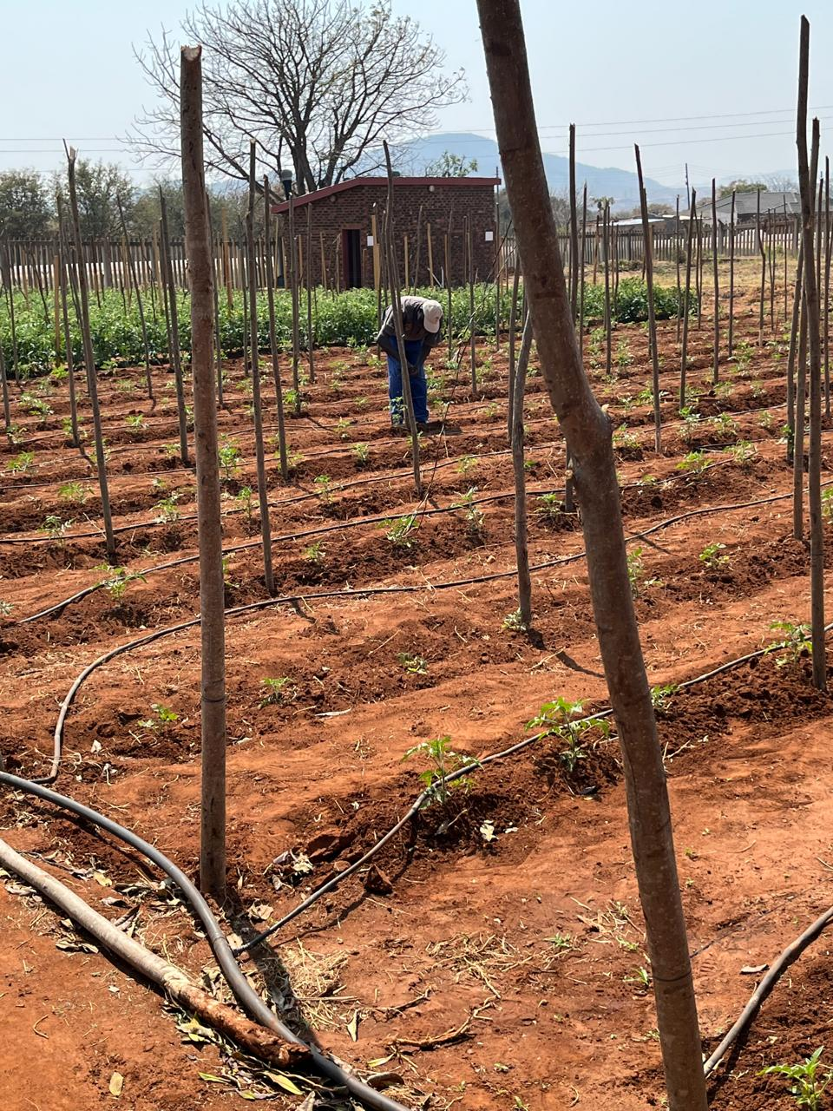
FARMER AT WORK

Slide 5
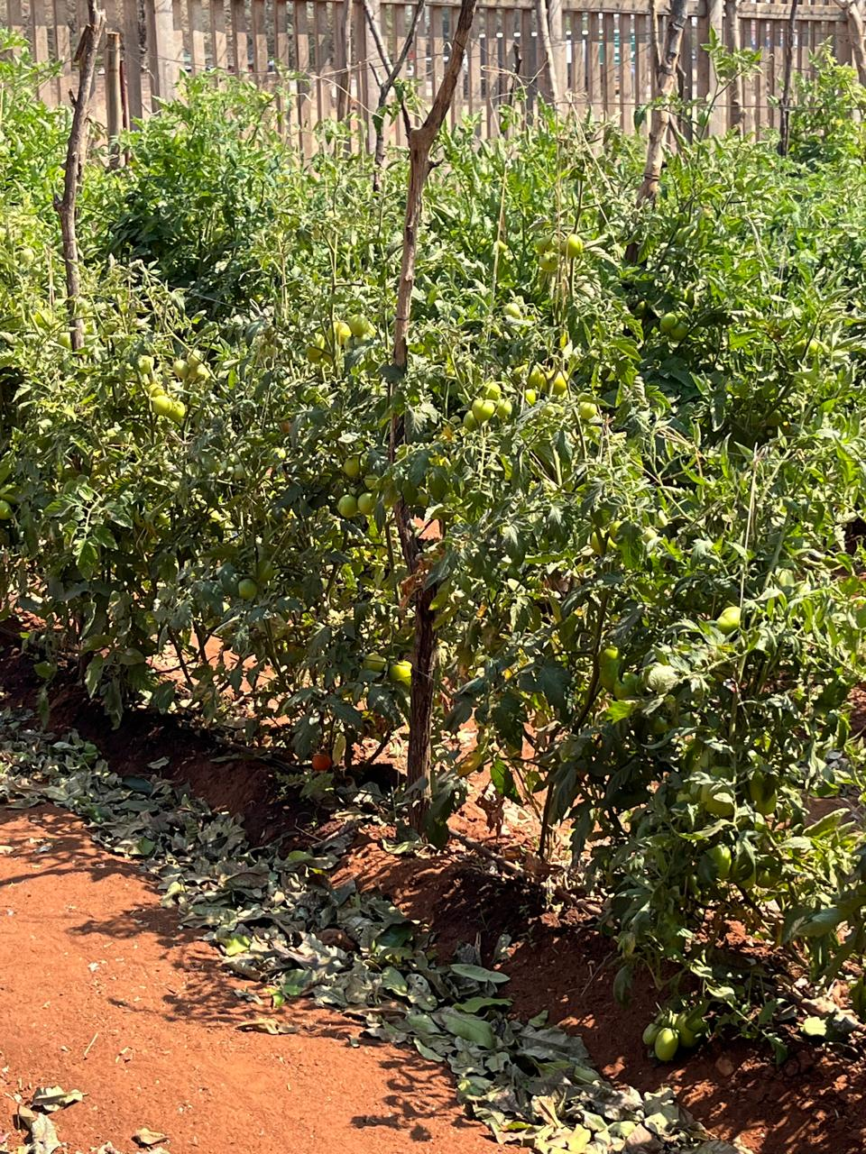
TOMATO TREE

Slide 6
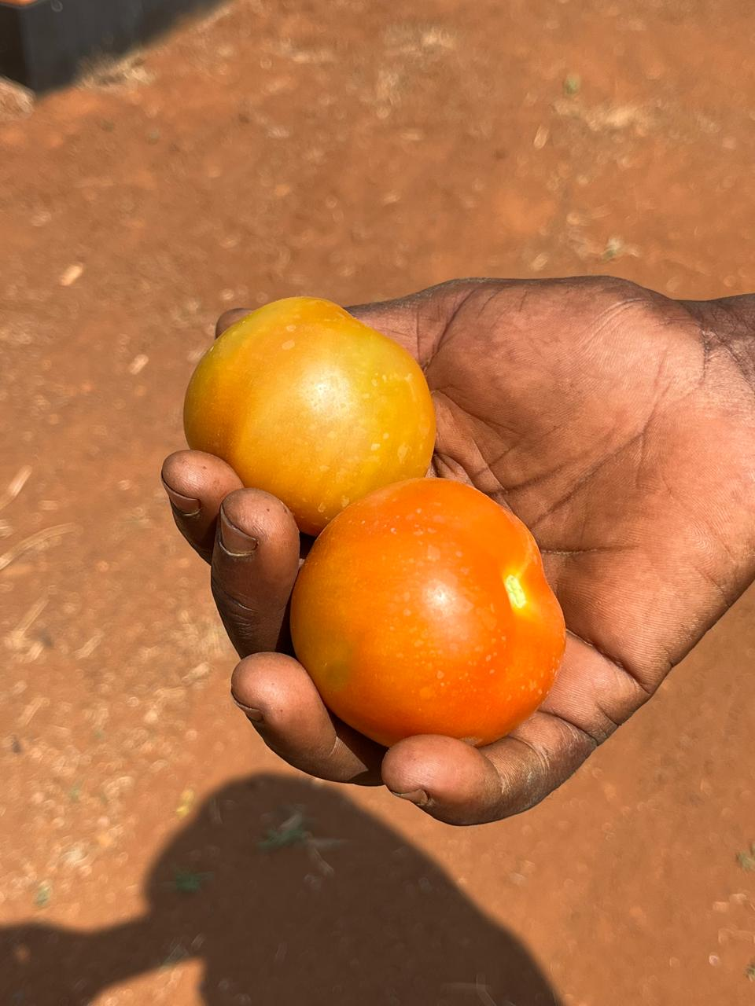
TOMATOES PRODUCED

Slide 7
CHALLENGES
The participants mentioned that selling is a challenge, as there is a huge competition; and their compotators give credits
Local buyers hardly support local business without having to request for discounts
A challenge of finding chemicals for crops due to distance and lack of reliable transport
Challenges of irrigation systems due to persistent warmer weather conditions

Slide 8
SOCIAL WORKER INTERVENTION
The role of a broker. The social worker linked the participants with the Department of Health to provide land and water for farming, and the Department of Agriculture to provide seasonal seedlings.
The social worker enabled the participant through solution focused approach to utilise available resources to minimise their faced challenges.
The Social Worker has fostered community resilience through strength perspective by integrating Green Social work

Slide 9
CONCLUSION
Not only limited to the farmers, broad knowledge on keeping the earth green can help manage the climate
Better understanding of climate change can make people know how to protect their crops
Only if locals could support local grown crops

Slide 10
RECOMMENDATIONS
Getting equipped with more knowledge on farming
Searching for sponsor
Encouraging people to buy local crops/vegetables
Transfer of skills to the younger generation
Empowering to utilize available resources

