Slide 1
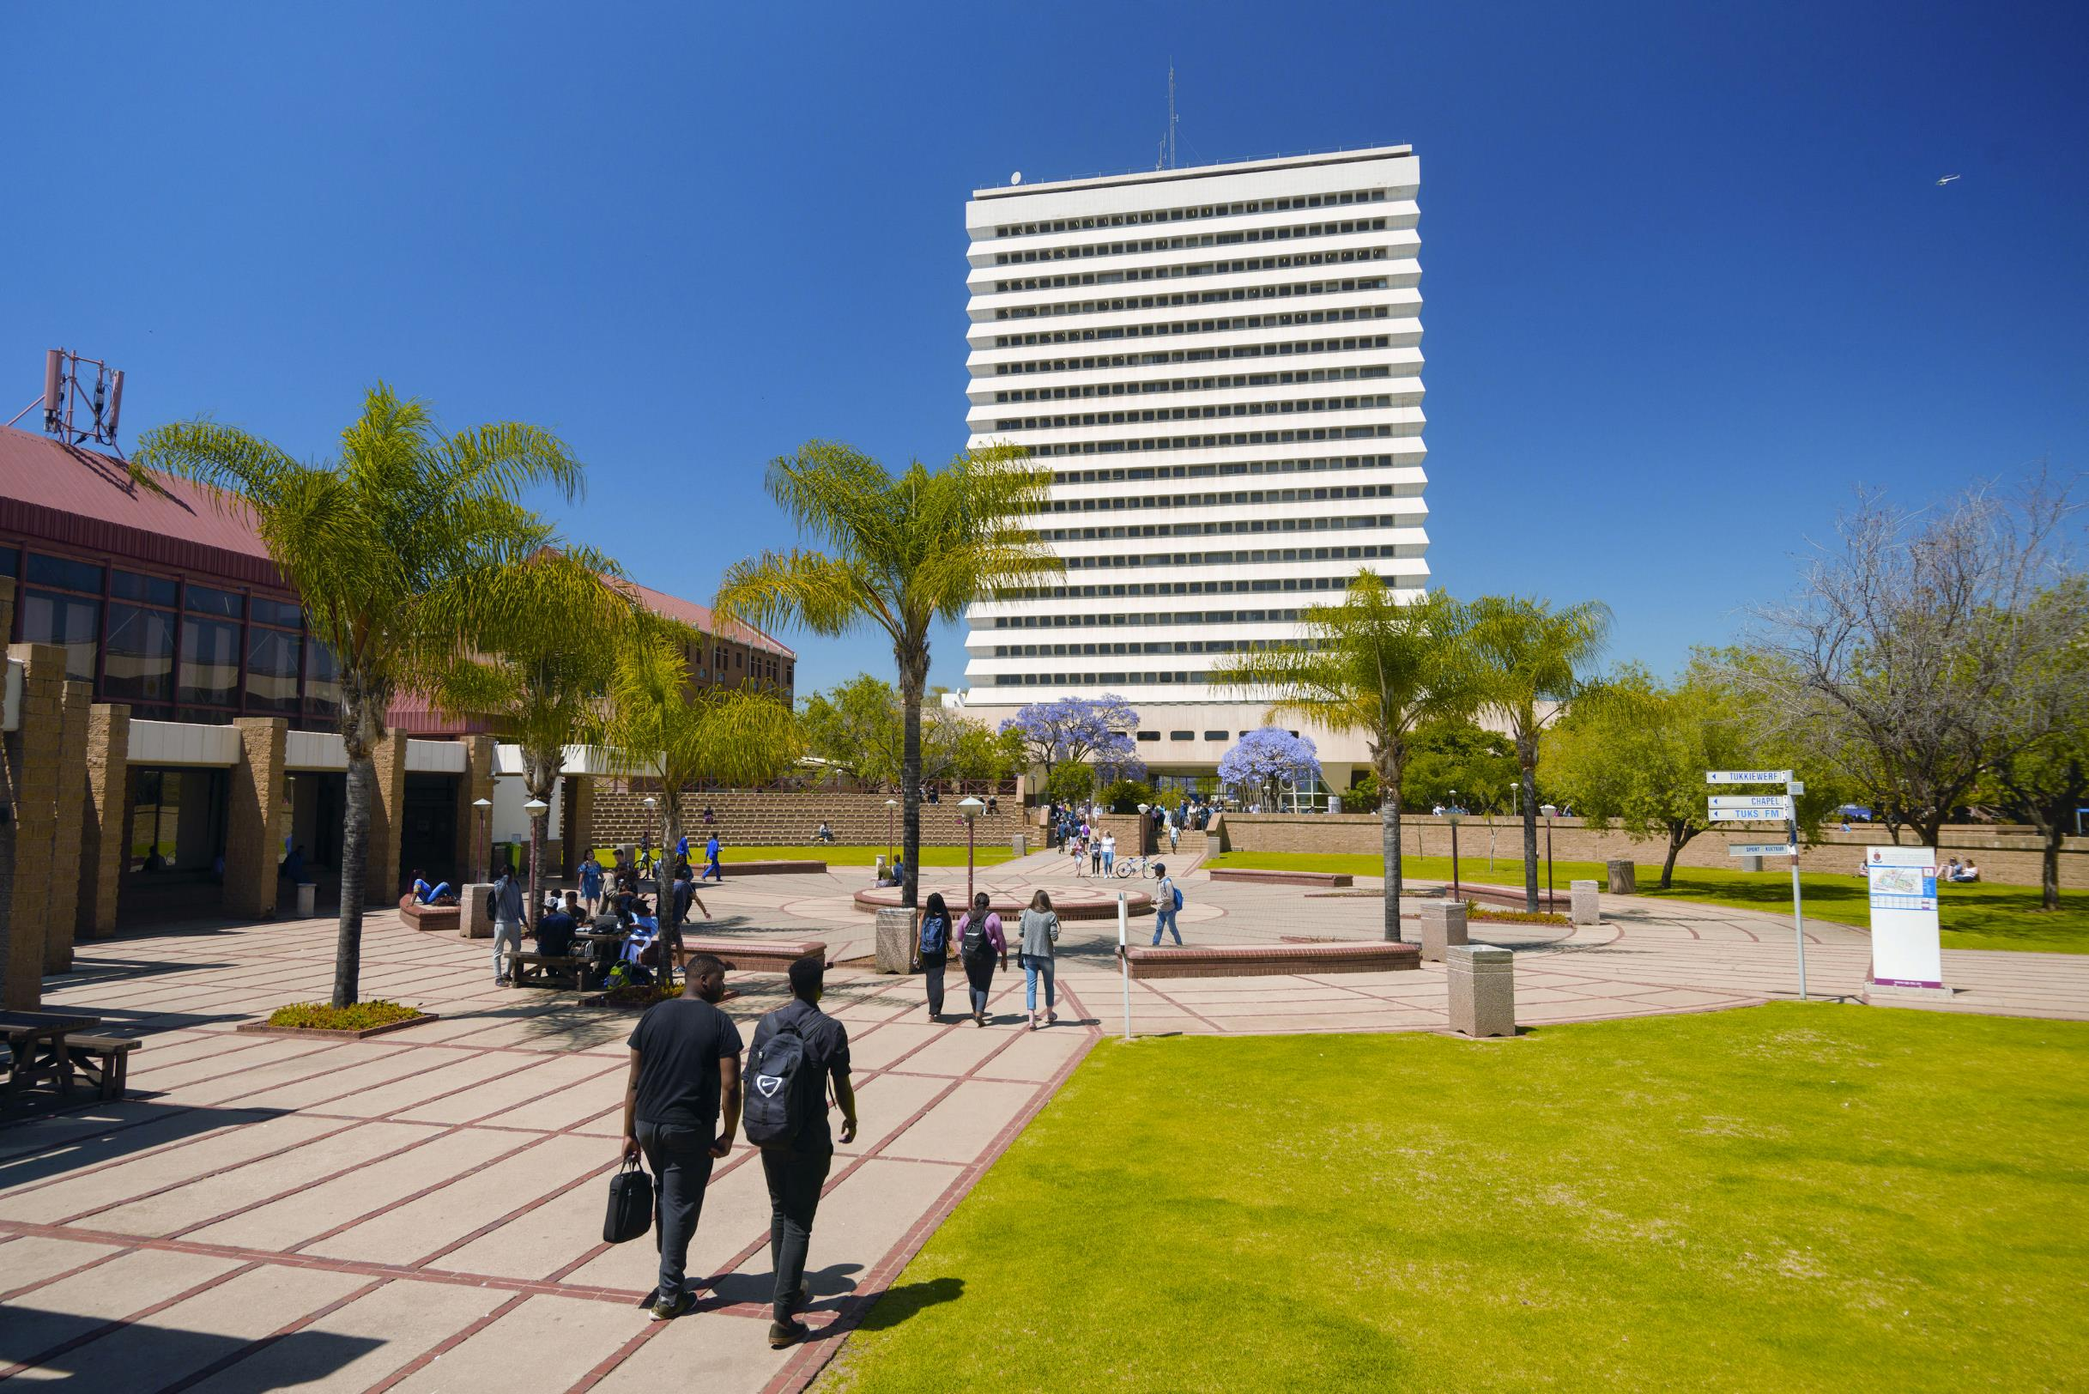

GROWING OLDER IN SUB‐SAHARAN AFRICA:
A CRITICAL RAPID REVIEW OF LITERATURE ON RESILIENT AGEING
Dr. Elizabeth A. Ajayi
Postdoctoral Research Fellow, Dept. of Social Work & Criminology,
Faculty of Humanities, University of Pretoria, South Africa
Presented at ASASWEI 2025 Conference
University of the Free State, Bloemfontein
10-12 September 2025

Slide 2
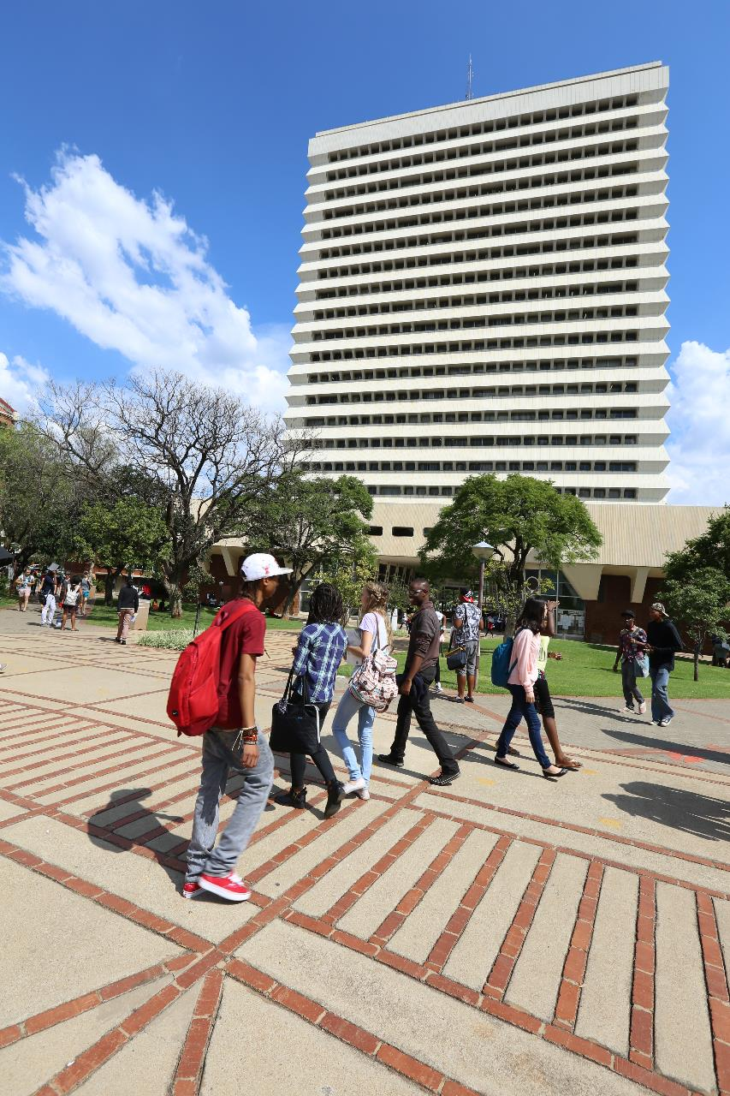

INTRODUCTION
SSA rapid demographic change.
Older persons: 74m → 235m by 2050 (He et al., 2020).
Ageing amidst poverty, poor healthcare, urbanisation, weak traditional supports, modern transformations and neoliberalism.
Resilience enables older persons to cope with adversity, restore psychological health, and maintain quality of life (QoL) despite challenges.
Most research in SSA focuses on ageing problems and the conversation surrounding resilient ageing, dominated by discourses from Western contexts.

Slide 3
AIM & RESEARCH QUESTIONS
Aim:
To synthesise empirical evidence to explore the concept of resilient ageing in SSA
To critically oppose the predominance of Western discourses on resilient ageing
To challenge the emphasis on individualist concepts of resilience; and
To highlight the significance of contextual and structural drivers of resilience.
Questions:
What does resilient ageing mean in SSA?
What mediative resources influence resilience among older persons in SSA amidst precarity?
What results are associated with resilient ageing in SSA?

Slide 4
METHOD: RAPID REVIEW
Databases:
Web of Science
EBSCOHost
Google Scholar
Inclusion criteria:
Empirical studies on resilient ageing in SSA
Published between 2022–2025
Focus on older adults (60+) and resilience-related outcomes
Available in English
Peer-reviewed articles
Exclusion criteria:
Non-empirical studies (reviews, commentaries, editorials)
Studies outside SSA
Published before 2022
Focused on populations other than older adults
Non-English publications

Slide 5
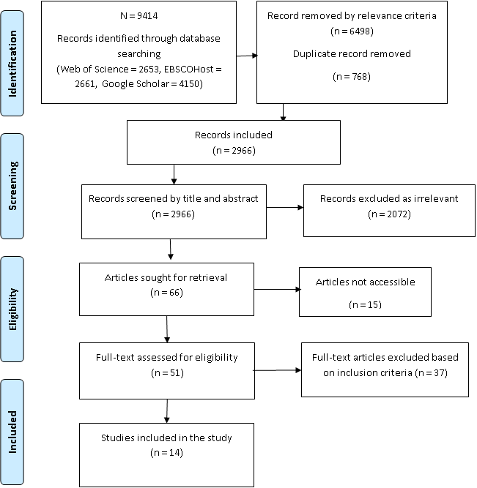
METHOD: SELECTION PROCESS & ANALYSIS
PRISMA Flow Chart
Quality assessment:
Robustness of the results
Conceptual clarity
Methodological rigour
Overall trustworthiness
Data analysis and synthesis:
  Reflexive thematic analysis (deductive + inductive) (Braun and Clarke, 2022)
  Integrate findings into new, broader themes

Slide 6
FINDINGS: DATA Characteristics

Slide 7
findings: Themes and Subthemes
Theme |  | Sub-themes
1 | Adaptive capacity | 1.1 | Psychological and mental resilience
 |  | 1.2 | Personal faith and religiosity
 |  | 1.3 | Agency beyond gender and cultural dictates
 |  | 1.4 | Adaptive health-seeking behaviour
 |  | 1.5 | Educational level and use of technology
2 | Social network | 2.1 | Close family bonds
 |  | 2.2 | Community-level resilience
 |  | 2.3 | Intergenerational support
3 | Cultural and spiritual resources | 3.1 | Cultural norms, identity and practices
 |  | 3.2 | Religious solidarity and network
4 | Economic capital and capacities | 4.1 | Livelihood strategies and remaining active economically
 |  | 4.2 | Fostering independence and self-worth through financial stability
5 | Structural arrangement through policy interventions | 5.1 | Social and economic policies
 |  | 5.2 | Access to Socio-economic intervention
 |  | 5.3 | Systematic change advocacy

Slide 8
KEY FINDINGS
Resilient ageing in SSA:
Intra-personal strengths (willpower, optimism, skills)
Culture-social network (family, faith networks, cultural rituals, community organisations)
Hybrid systems that combine informal networks, spirituality, and little public services
Resilient ageing mediative factors:
Biopsychosocial
Social network
Adaptive livelihoods and financial strategies
Digital inclusion
Cultural and spiritual practice
Environmental supports
Structural intervention
Resilient ageing outcomes:
Autonomy, dignity and psychological wellbeing
Sustained health and functionality
Financial security
Social integration and cultural-spiritual vibrancy

Slide 9
CRITICAL GAPS AND FUTURE DIRECTIONS
Gaps:
Narrow focus on Christianity; neglect of other spiritualities
Few indigenous/cultural frameworks
Mostly small-scale, cross-sectional studies; regional imbalance
Underrepresented groups (men, high-care needs, LGBTQ+)
Weak policy/programme evaluation and measurement tools
Future directions:
Longitudinal, mixed-methods across SSA
Explore traditional health and spirituality intersections
Include diverse, marginalised subpopulations
Test social protection, healthcare, and digital inclusion impacts
Develop Afrocentric, empowerment-based frameworks

Slide 10



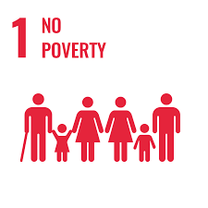
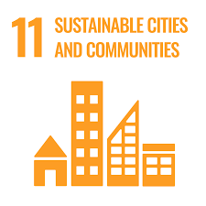

IMPLICATIONS & SDG LINKS
Policy and practice priorities:
Universal healthcare and geriatric services
Gender-responsive strategies and support for vulnerable groups
Expanded pensions and social grants for financial resilience
Age-friendly spaces and intergenerational initiatives
Empowerment through financial, health, and digital literacy
Community partnerships with religious/traditional leaders
Role of social work:
Bridge formal support (healthcare, pensions, policies) with traditional coping (family, spirituality, community)
Promote sustainable, Afrocentric development through evidence-based, multisectoral interventions

Slide 11

CONCLUSION
Although the informal networks and spirituality are beneficial, the significance of the absence or insufficiency of formal social protections (cash transfers, pensions, healthcare, housing), and the prevailing adverse structural conditions led to a context of hardship and adversity.
To ensure resilient outcomes that will achieve the SDGs, it is necessary to acknowledge the need for significant strengthening of structural interventions (pensions, healthcare access, anti-discrimination laws, gender equity policies) to lessen the overwhelming reliance on informal coping mechanisms.

Slide 12
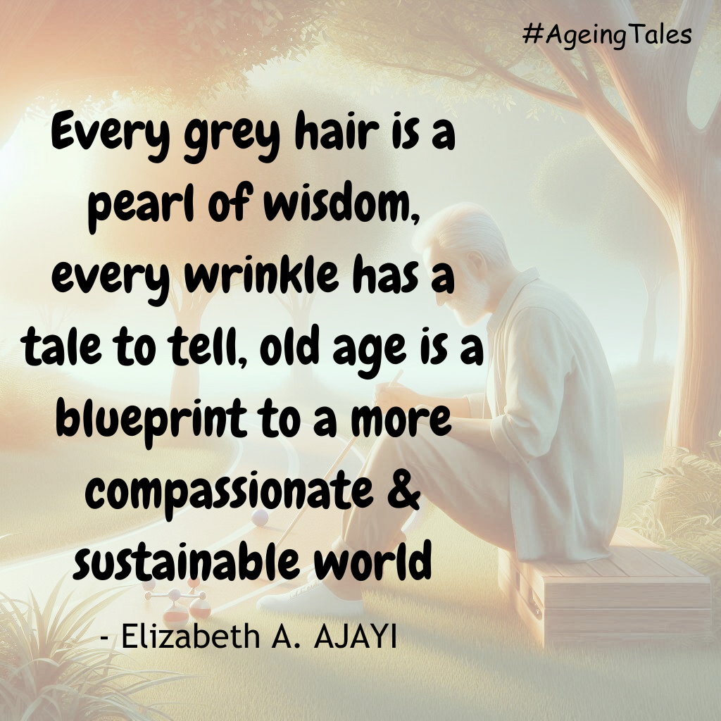


Slide 13



Thank you for listening!
Q & A
CONTACT DETAILS
Dr. Elizabeth Aanuoluwapo Ajayi
Department of Social Work and Criminology, University of Pretoria
elizabeth.ajayi@up.ac.za
www.linkedin.com/in/elizabethaanuoluwapoajayi

