Slide 1
AN EVALUATION OF 16 DAYS OF ACTIVISM OF NO VIOLENCE AGAIST WOMEN AND CHILDREN CAMPAIGN IN PHUTHADITJHABA AREA
D.H.S. MPHUTHI
SOCIAL WORK MANAGER
THABO MOFUTSANYANA DISTRICT DATE: 11 SEPTEMBER 2025

Slide 2
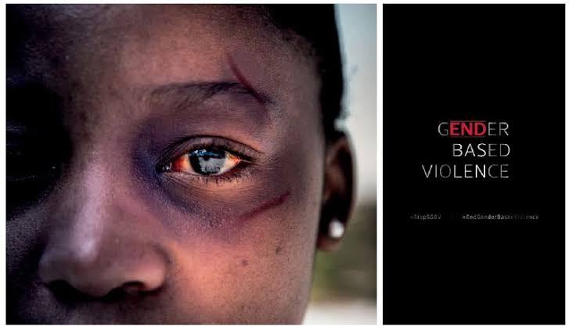
INTRODUCTION AND BACKGROUND
16 Days of activism against GBV is an annual international campaign running from November 25th to December 10th to raise awareness and mobilize action to end violence against women and children.
GBV activists need to know and to demonstrate that their GBV prevention activities are effective, that they are impacting knowledge, attitudes and behaviours, that they are reviewed regularly and revised in order to optimize their effectiveness. (Abrahams et al. 2013)
This requires sound monitoring and evaluation methodologies to facilitate an improvement in programme quality and responsiveness to ensure greater accountability to participation and wider community.
This study seeks to evaluate the effectiveness of the 16 Days campaign and was conducted in Phuthaditjhaba.

Slide 3
METHODOLOGY
The study utilized qualitative research approach as it focuses on non numerical data to understand experiences, perspectives and details.
Data was collected using semi structured interviews, because it helps the researcher to understand the respondents opinion and experience pertaining to a specific topic or event.
The researcher used purposive sampling method from the Phuthaditjhaba area, 40 respondents were sampled from the population, 20 female and 20 males from the ages of 25-55.
Ethical considerations were also done.

Slide 4
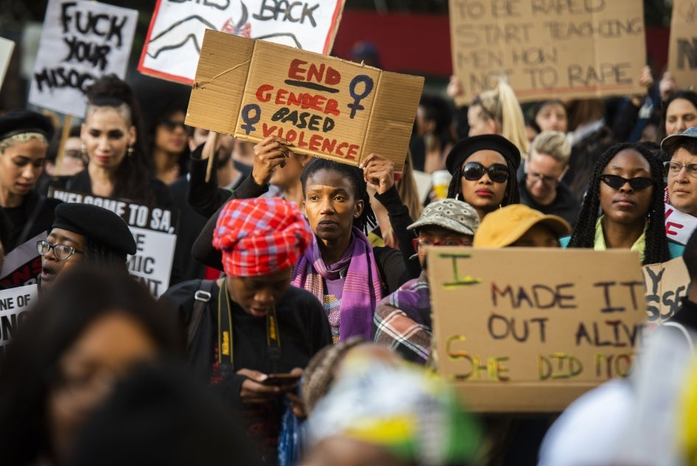
DISCUSSIONS AND FINDINGS
Statistics of GBV continue to rise despite awareness campaigns.
Second pandemic in South Africa
Underreporting of cases persist in communities.
Short term focus – emphasis is on 16 days can create a perception that GBV is a seasonal issue, leading to decreased attention and efforts for the rest of the year.
Address the root cause which include :-
Deep seated patriarchy and gender inequality

Slide 5
CONTINUATION……………………
Poverty and high unemployment rates
Harmful social and cultural practices
So, we could ask, what is the point of 16 Days campaign. Is this awareness raising campaign really useful and what impact does it have?
One of the campaign challenges is that it tend to put the onus for effecting change on the individual, as if this was an individual level issue.
There is neglect on the underlying structural and systematic factors within which violence occurs.

Slide 6
CONTINUATION……………..
Study found that in Phuthaditjhaba, being a victim of GBV is perceived as shameful and weak being considered guilty of attracting violence against themselves through their behaviour. Hence there is low level of reporting and investigations.
Amongst the crimes that were reported, the study found that in Phuthaditjhaba, the highest crime committed was rape, sexual assault. The rate of sexual assault in SA is among the highest recorded in the world.
75% of respondents were concerned about access to justice, they mentioned to have lost confidence in the courts.
Lastly, the most claring finding was that the male respondents knew or heard about the 16 days campaign but were not interested.

Slide 7
CONCLUSION
It is important to note that patriarchy should be eradicated if we are all serious about rooting out GBV in our society.
Violence is also intergenerational occurring in a continuum from childhood to adulthood.
A large proportion of women who experienced violence and men who perpetuate violence have experienced it in their childhood.
Many of the findings in this study point to conservative and patriarchal value system for men and women.

Slide 8
LESSONS LEARNT
The effectiveness of 16 Days campaign has been hampered by a lack of documentation and results assessments.
Localizing the campaign messages and themes eg “not in our name”.
Media and GBV. Media can negatively influence GBV by perpetuating harmful stereotypes and normalizing violence which contributes to real-world abuse.
Most of the respondents in this study had misinformation and victim blaming. They also had conservative attitudes towards rape and survivors.

Slide 9
CONTINUATION…………….
Phuthaditjhaba is one area where traditional leaders are respected by the communities. Therefore the “LEKGOTLAS” in the communities play an important role in providing platform to engage and to disseminate information.

Slide 10
RECOMMENDATIONS
Need to strengthen and support TCC Centres ( turn victims into survivors) eg. There is a newly opened one in Phuthaditjhaba.
The need to implement comprehensive education programme from young age to challenge patriarchal attitudes, understand what is consent and address the root cause of GBV.
Involvement of the Minister’s fraternal or traditional leaders to be part of the local VEP Forum as they are key stakeholders.
Revive the Rapid Response Team to ensure the support of the victims for coordinated multisectoral responses.

Slide 11

CONTINUATION………………
Increase funding for GBV initiatives.
Research must invest in collecting data to understand trends, evaluation interventions and adapt strategies for better outcome.
Shift from a 16 Days focus to 365 days of activism approach, and training on NSP document.

