Slide 1
Limpopo Province
Vhembe District
GREEN SOCIAL WORKER AND CLIMATE RESILIENCE SUPPORTING VULNERABLE COMMUNITIES IN THE FACE OF CLIMATE CRISES
2025 ASASWEI PRESENTER : MADAVHA TSHILIDZI BALCAN

Slide 2
1. Introduction
Green social work operates at multiple levels of practice, from individuals to communities and to global systems. Social workers actively participate in social action at both the micro and macro levels as an integral aspect of their responsibilities as agents of change.
The focus that social work places on community is one of the ways in which it differentiates itself from other professions such as psychiatry, psychology, and counselling. When making assessments and providing remedies for social problems, social workers take into account the social environments in which their clients reside (Ritchie, 2010). It is however essential and helpful for social workers to travel outside the boundaries of society in order to have a more comprehensive understanding of human suffering (Kondrat, 2013).

Slide 3
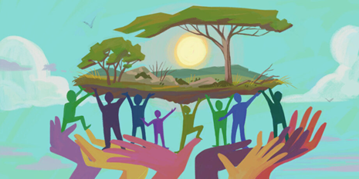

2.Definition
GREEN SOCIAL WORK: refers to the growing movement within the profession to address environmental challenges through practice.
CLIMATE RESILIENCE : The ability of individuals, communities, and ecosystem to prepare for, recover from, and adapt to the climate impacts of climate change

Slide 4
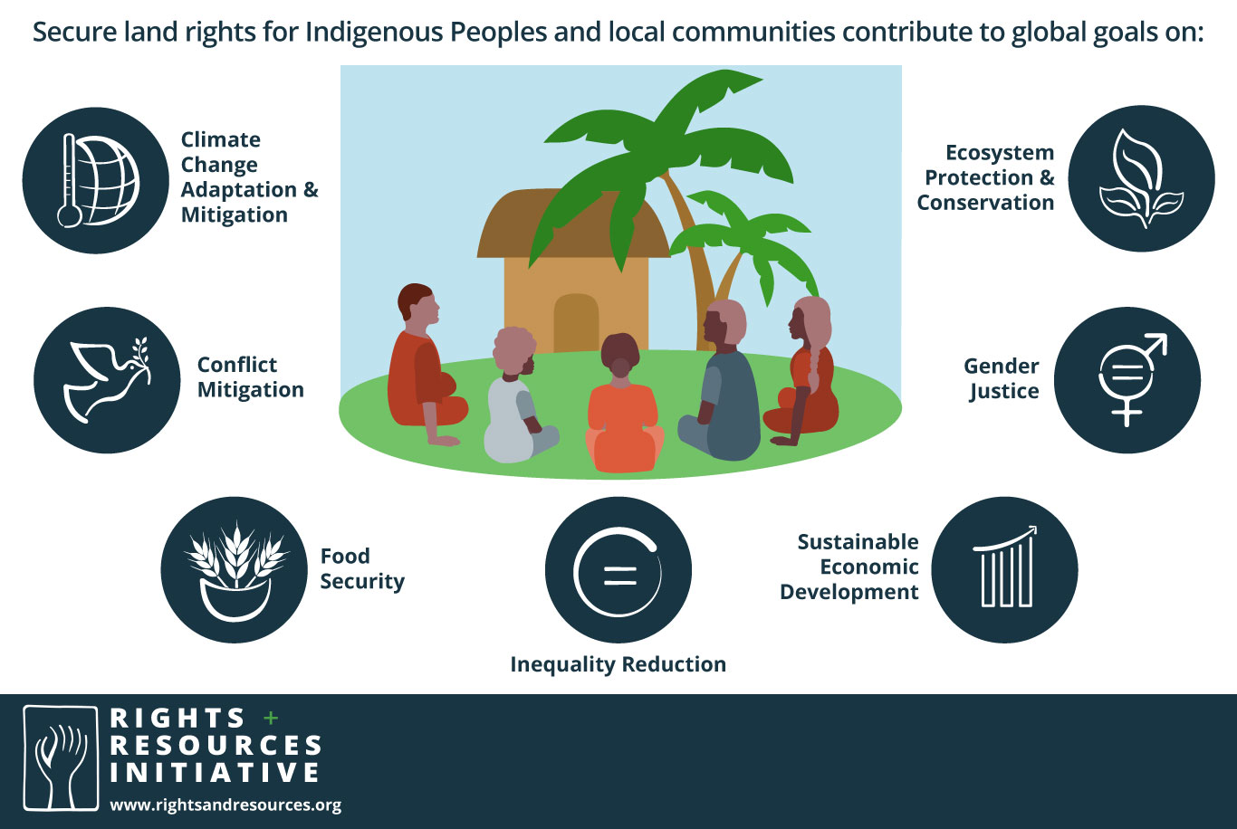
Definition continue…..
VULNERABLE COMMUNITIES : it is groups of individuals who are at an increased risk of adverse health outcomes due to a variety of socioeconomic, environmental, and health-related factors.
ENVIRONMENTAL CRISES : It is a significant and rapid changes in the planet's ecosystems, primarily driven by human activities, leading to severe issues such as climate change, pollution, deforestation, and biodiversity loss.

Slide 5
3.The Importance of social worker on environmental crisis
Increased health risks: Respiratory problems , and Mental health
Disproportionate Effects: low-income communities, indigenous communities
Environmental injustice: social and economic inequalities
Human Rights : right to clean air, water and healthy environment

Slide 6
4.Roles of social workers on environmental crises
1. Advocacy : social worker advocate for the rights and needs of affected communities, ensuring their voices are heard. Speaking to relevant stakeholders in relation to the crises experienced by their clients.
2. Emotional Support: social workers provide emotional support to individuals and communities affected by environmental crises. ( psychosocial support and support groups)
3. Education and awareness : educating communities about environmental risks and promote sustainable practice. ( floods and projects.
4. Trauma support : provide support to individuals and communities experiencing trauma due to environmental crises. (counselling and debriefing
5. Collaborator : social worker collaborate with environmental professionals, policy makers, and other stakeholders to address environmental crises and promote sustainable solutions
6. Researcher : conduct research on the social and environmental impacts of environmental crises, information practice, policy and advocacy effort.

Slide 7
5. Green social worker levels of practice
The social work profession engages across micro-mezzo-and macro levels of policy and practice to co-build partnerships that create change and promote opportunities that support and build sustainable development and eco-social practice, committed to building a new eco-social world in which all rights are ensured and no one is left behind.
1. Micro Social work focuses on individual clients and small groups. It involves direct interaction and support, often through counseling or therapy. Social workers provide one-on-one support, assess client needs, and help individuals navigate personal challenges. They may work as therapists, school social workers, or case managers.
Individual therapy sessions , family counselling and crisis intervention

Slide 8
5. Cont…
2. Mezzo
Social work operates at the community or group level, bridging the gap between individuals and larger systems.
Social workers engage with groups, organizations, and communities to facilitate support and intervention programs. The aim is to strengthen group dynamics, empower communities, and create supportive networks that improve collective well-being.
E.g.: Social worker facilitates support groups, conduct community outreach and awareness campaigns and strengthen families
3. Macro level
Social work encompasses broader systemic issues, focusing on policy, advocacy, and research to influence social change.
Social workers work on a larger scale, addressing societal problems through policy development, program implementation, and community advocacy. ( Collaboration)

Slide 9
6. Challenges of green social worker
1. Limited resources
Insufficient funding and resources can hinder the implementation of green social work initiatives, making it difficult to support communities affected by environmental crises
2. Climate change
The complexity and scale of climate change can be overwhelming requiring green social workers to develop innovative strategies to mitigate its effects and promote resilience
3. Advocacy
Advocate for policy changes and increased funding to support environmental sustainability and social justice initiatives
4. Interdisciplinary collaboration
Green social workers must collaborate with professionals from various, including science, technology, and public health, to develop comprehensive solutions to environmental challenges

Slide 10
7.Strategies to overcome challenges faced by green social worker
1. Develop community-based initiatives
Empower local communities ta take ownership of environmental projects and develop sustainable practices
2. Provide education and training
Offer training and education programs to enhance the skills and knowledge of green social worker and community members
3. Foster partnership
Collaborate with government, NGOs, and other stakeholders to leverage resources and expertise

Slide 11
9.Conclusion
.
To increase climate resilience means one has to reduce the climate vulnerability of people, communities and countries
To make societies more resilient, climate policies and plans should be shaped by choices that support sustainability
Climate resilience is a multifaceted approach that requires coordinated efforts across various sectors and levels of society. By enhancing resilience, communities can better cope with the challenges posed by climate change and work towards a sustainable future.

Slide 12
THE END
THANK YOU !
NDO LIVHUWA .
NDAA!

